Slide 1
Easter
is the most important time in the Church’s liturgical year.

Slide 2
The Easter Vigil
is celebrated on the Saturday evening before Easter Sunday.
The Easter Vigil has four parts.

Slide 3
Part 1:
The Service of Light
At the Easter Vigil, we gather in the dark.
After Good Friday, just like Jesus’ friends, we feel as if we are in darkness – sad and lost.

Slide 4
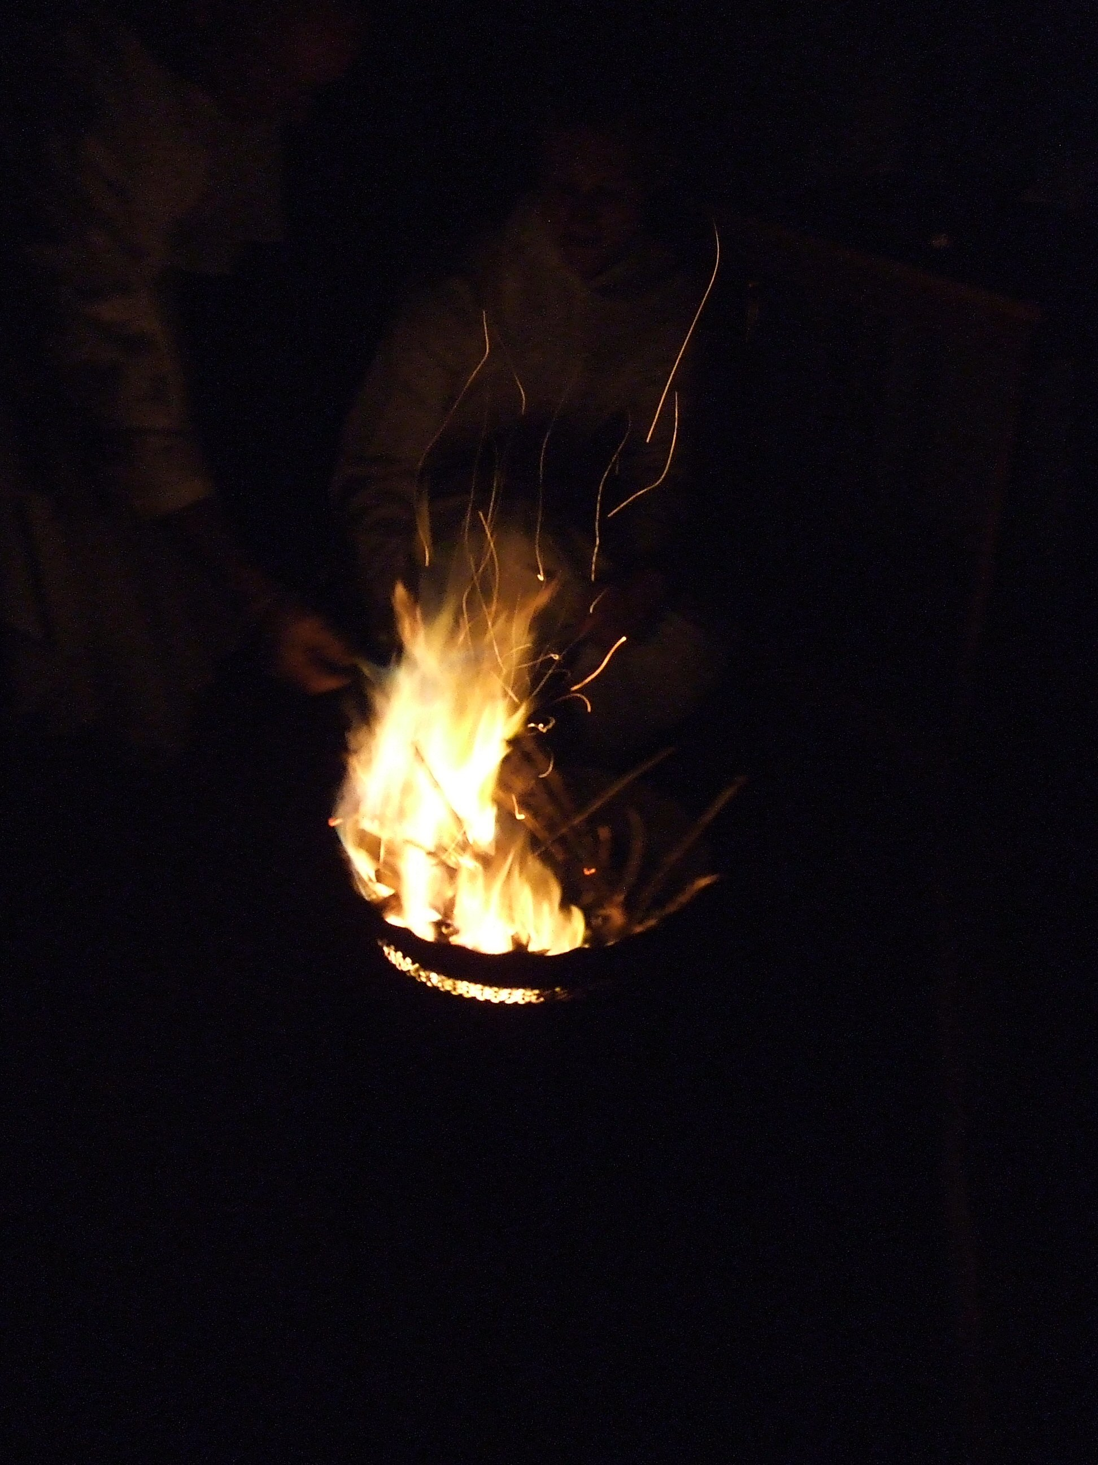
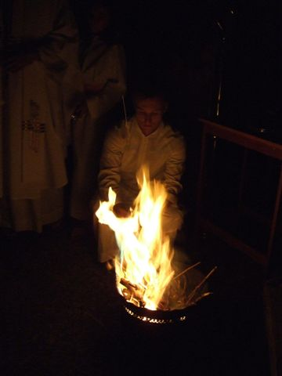
The Easter fire As the Vigil begins,
a fire is lit.
The fire gradually breaks into the darkness.

Slide 5
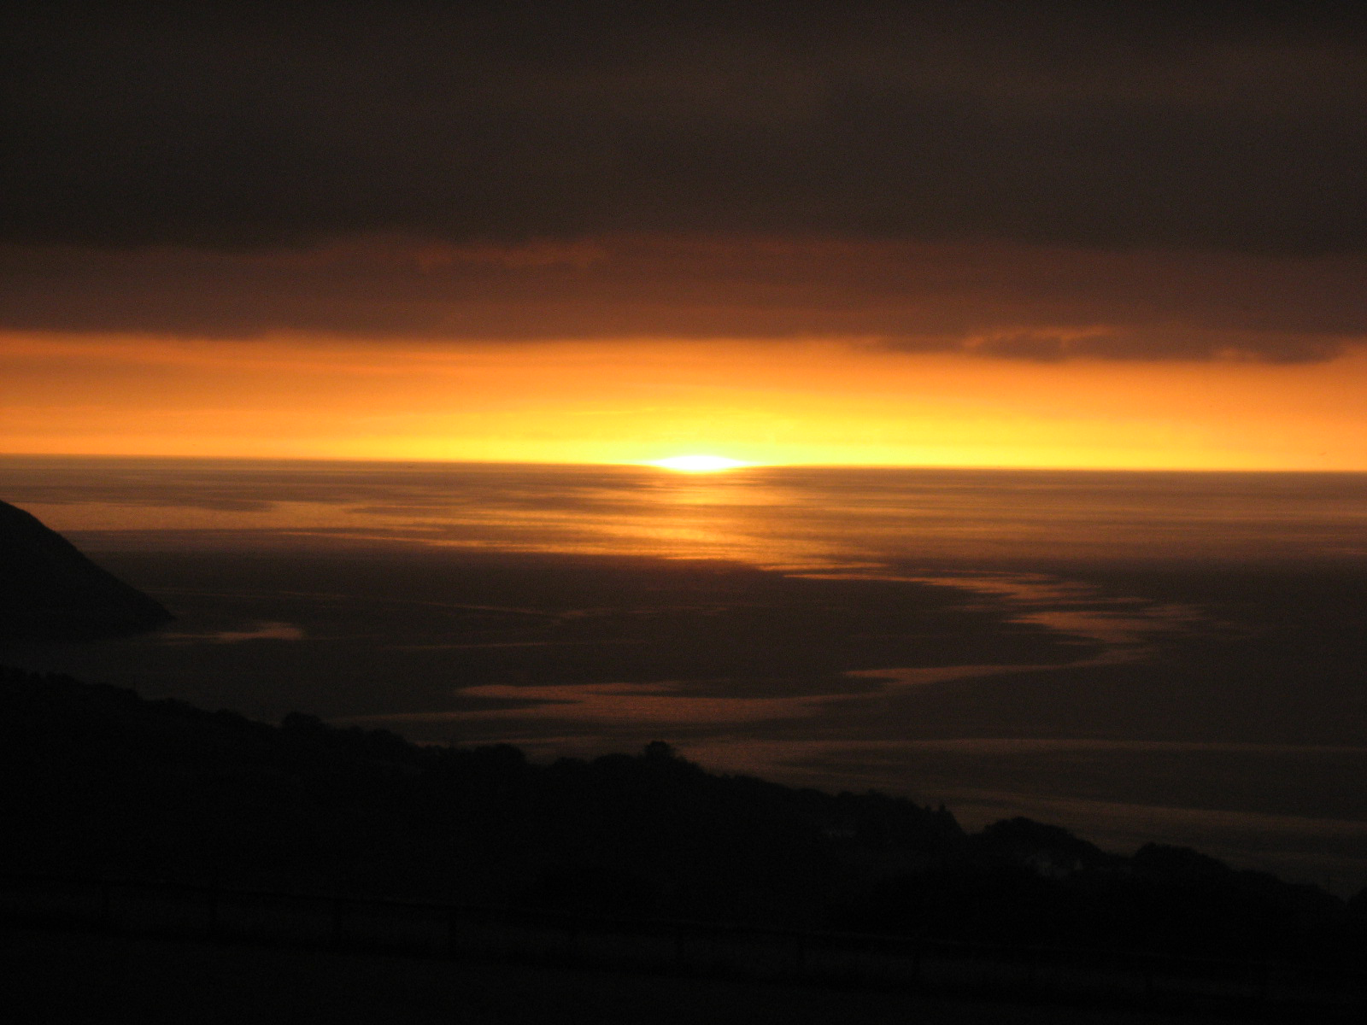
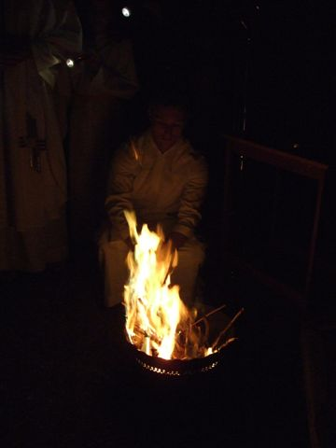
As the fire
grows in light
it reminds us
of that
first Easter
morning.

Slide 6
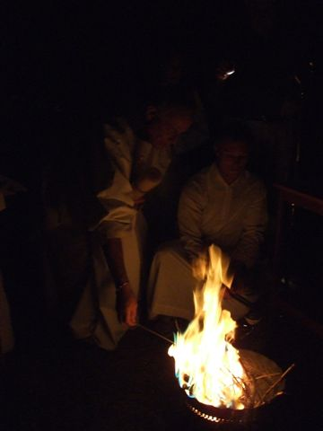
The great Easter candle,
the Pashcal candle,
is lit from this fire.

Slide 7
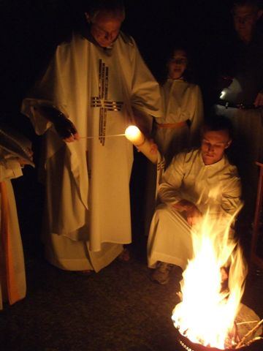
The Easter candle symbolises the risen Jesus – Light of the World.

Slide 8
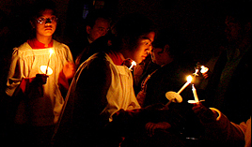
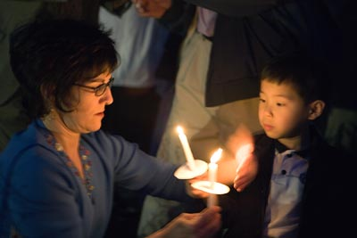
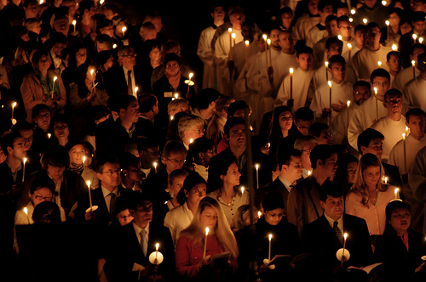
From the Paschal
candle the light
is passed from
person to person.

Slide 9
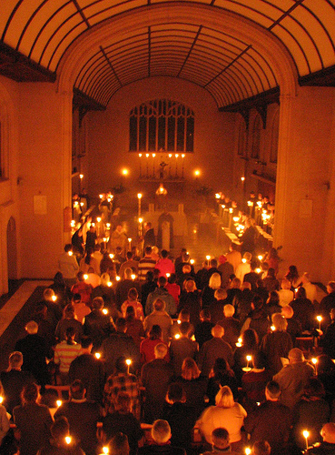

Slide 10
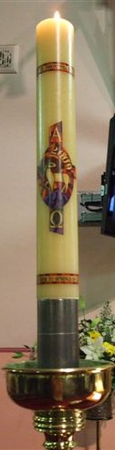
The priest then
places the
Paschal candle
on the candle stand.
.

Slide 11
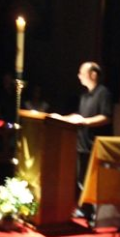
While the church is still in darkness, with only
the light of the Paschal candle
and the people’s candles,
the Risen Jesus is praised in
the Exsultet:
Rejoice heavenly powers!
Sing choirs of angels!
Exalt all creation around God’s throne!
Jesus Christ our King is Risen!
Sound the trumpet of salvation!

Slide 12
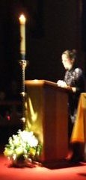
Liturgy of the Word
Part 2:
We listen to the wonderful things God has done since the beginning…
in readings from the Old and New Testaments.

Slide 13
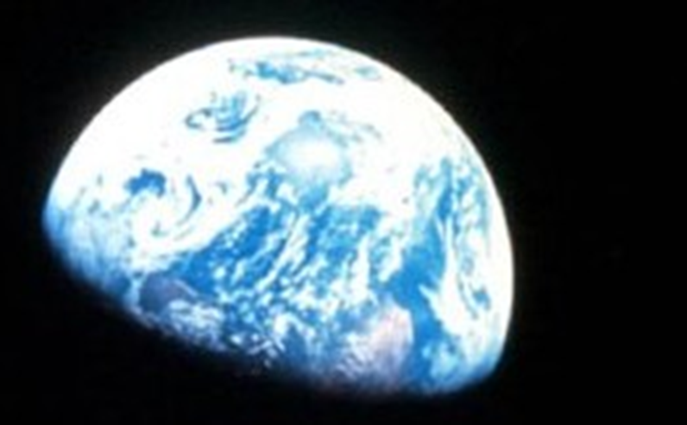
One reading from
the Old Testament
could be the creation story.

Slide 14
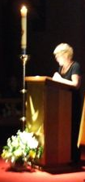
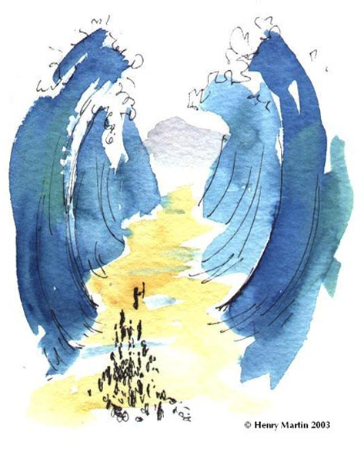
The story of the Exodus (14:15 - 15:1) is always read.
Used with permission from Henry Martin, http://www.sermons4kids.com/hmartin.htm

Slide 15
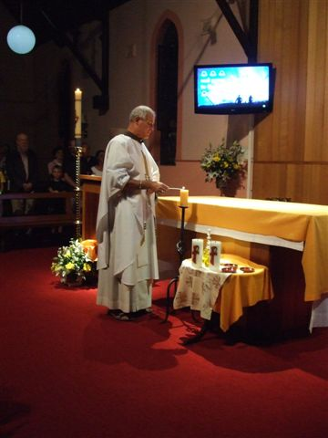
After each reading the amount of light in the church is increased.

Slide 16
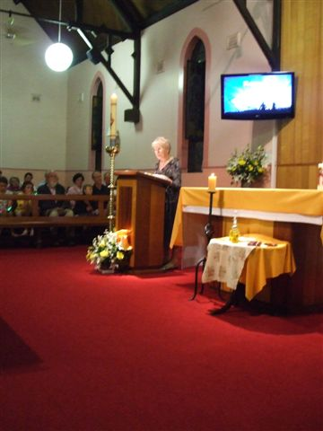
After each reading the amount of light in the church is increased.

Slide 17
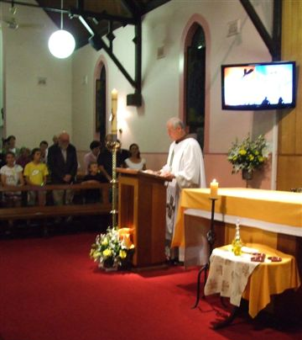
By the time
the priest reads the Gospel,
of Jesus rising from the dead,
the church is filled
with light.

Slide 18
The Liturgy of Baptism
Part 3:v
- the blessing of the water
- the blessing of the people
- the baptism of adults - the renewal of Baptismal promises

Slide 19
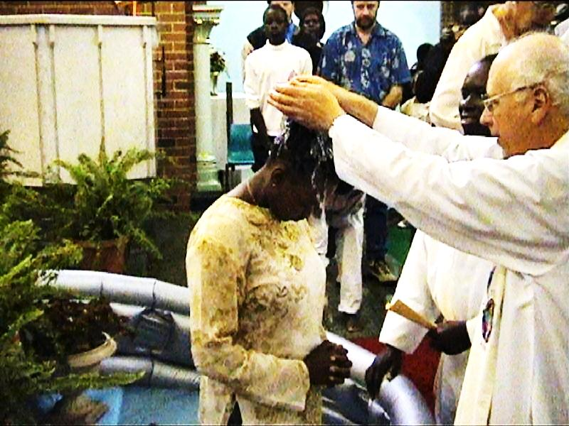
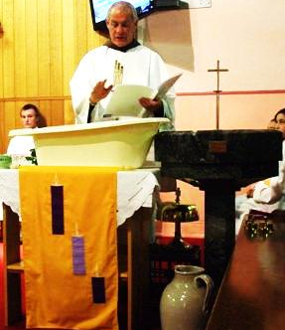
The water for Baptism is blessed.

Slide 20
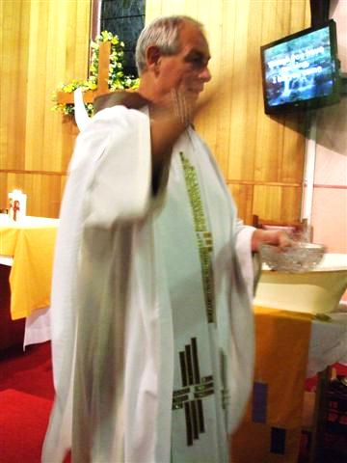
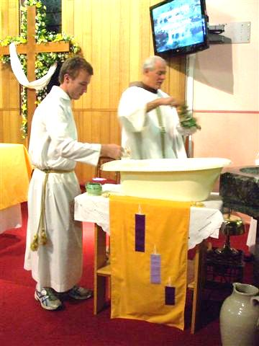
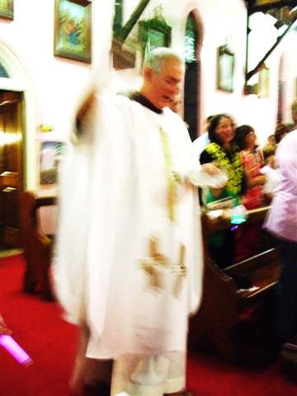
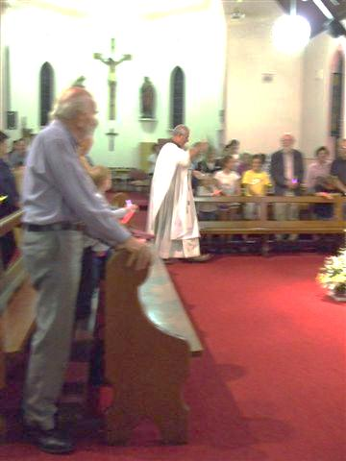
The people are then sprinkled with the water to remind them of their baptism.

Slide 21
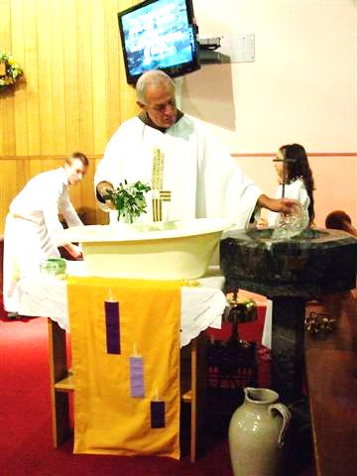
The blessed water is placed in the baptismal font and used to baptise new members of the Church.

Slide 22
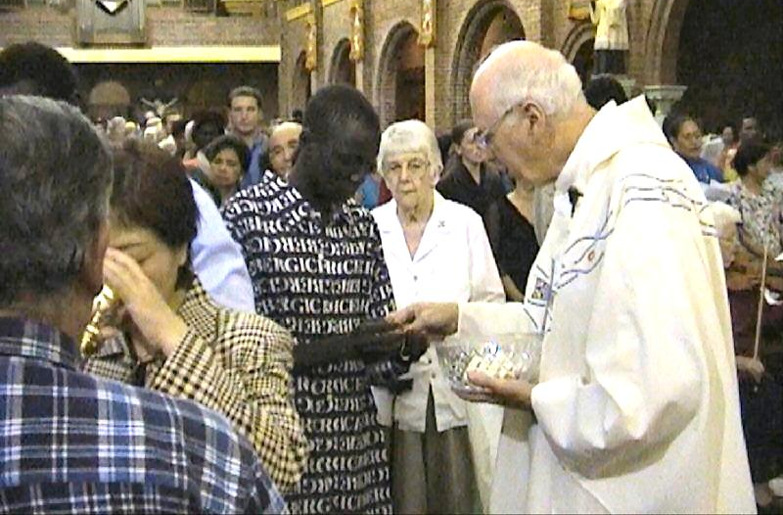
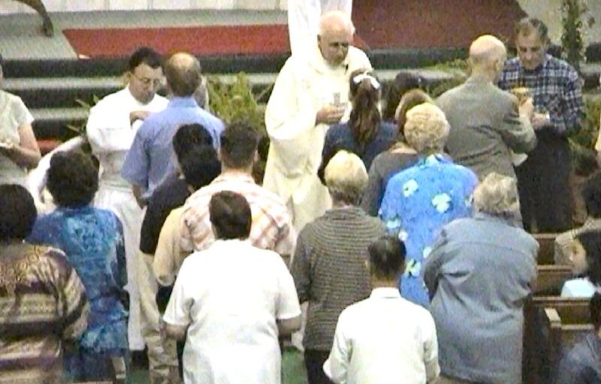
Liturgy of the Eucharist
Part 4:
We remember
what Jesus did
at the Last
Supper and we
celebrate it
again.
We give thanks for Jesus’ life, death and Resurrection.

Slide 23
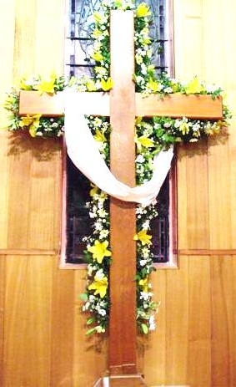
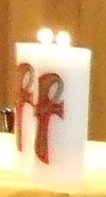
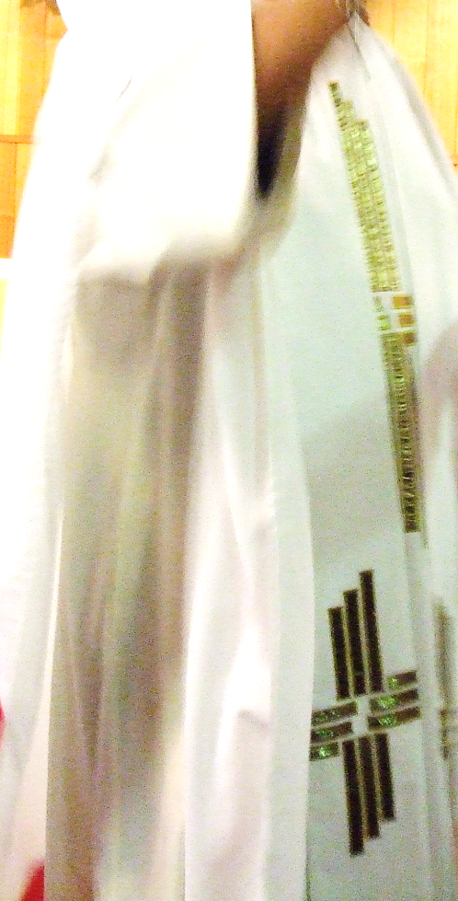
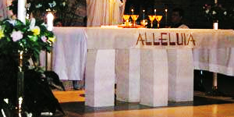
The church is now decorated in the white of the Easter season for fifty days.

Slide 24
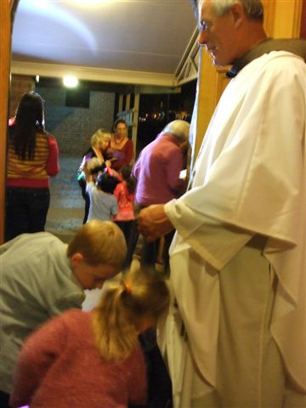
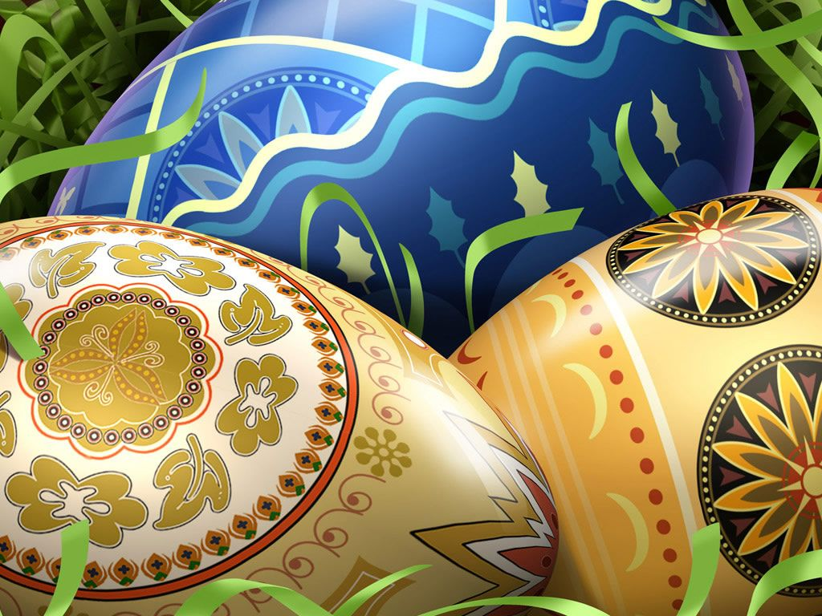
The Easter eggs we give one another are signs of the new life that the risen Jesus gives us.

